Slide 1
JANUARY
Downtime:
5/1/2024
23/1/2024

Slide 2
Network Disconnect on 5/1/2024
1423 HRS – 1534 HRS

Slide 3
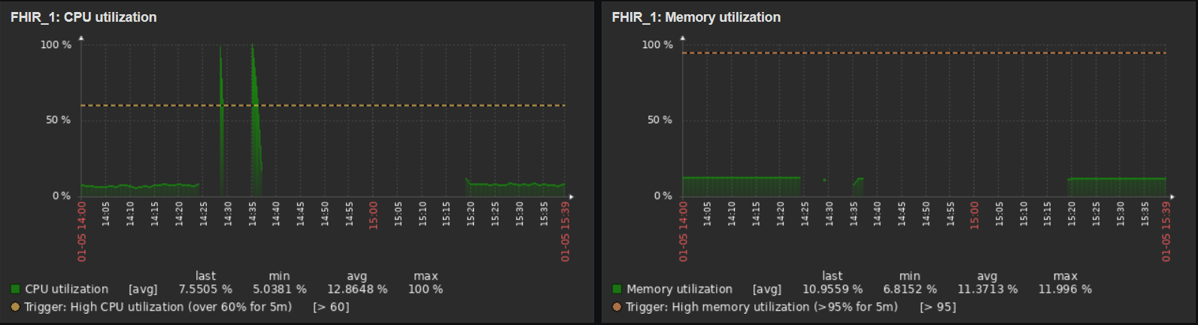
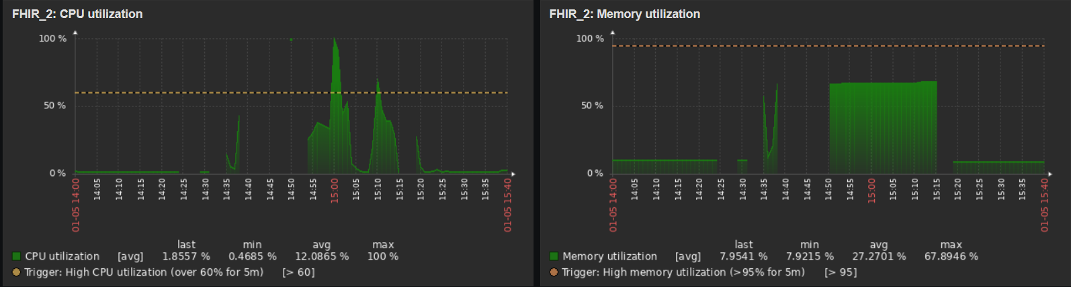
FHIR_1: CPU Utilization
FHIR_1: Memory Utilization
FHIR_2: CPU Utilization
FHIR_2: Memory Utilization

Slide 4
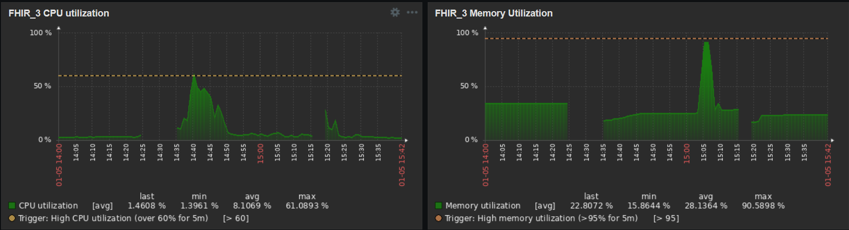
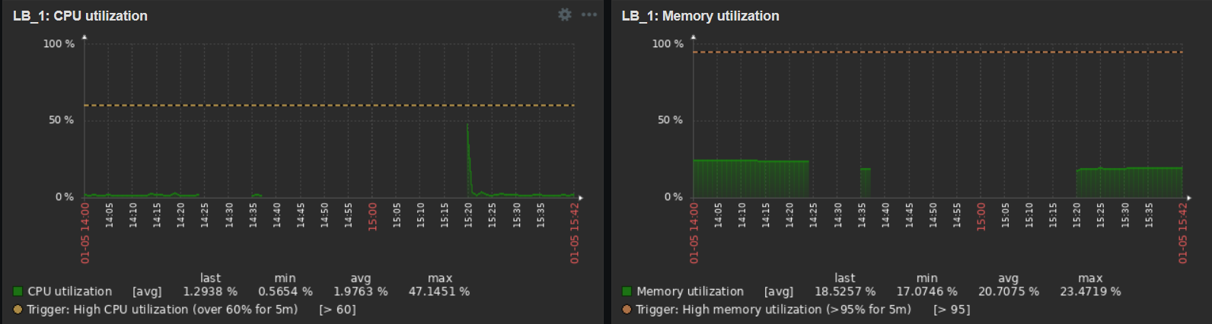
FHIR_3: CPU Utilization
FHIR_3: Memory Utilization
LB_1: CPU Utilization
LB_1: Memory Utilization

Slide 5
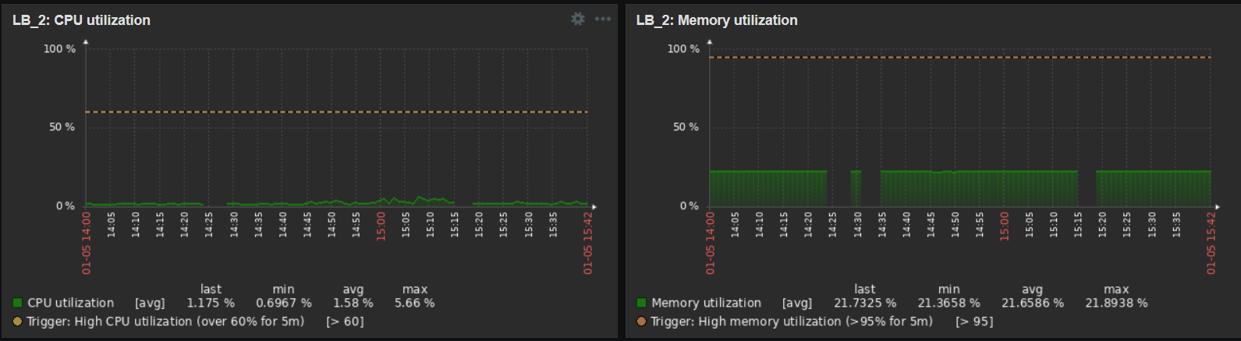
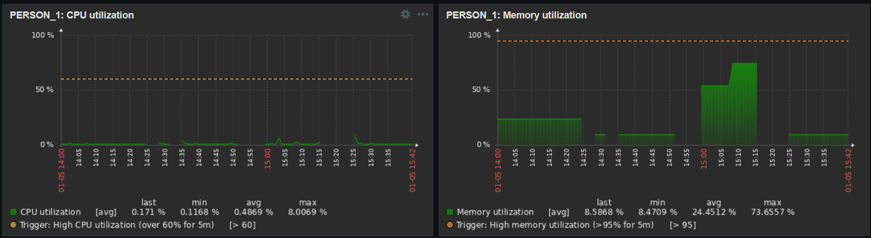
LB_2: CPU Utilization
LB_2: Memory Utilization
PERSON_1: CPU Utilization
PERSON_1: Memory Utilization

Slide 6
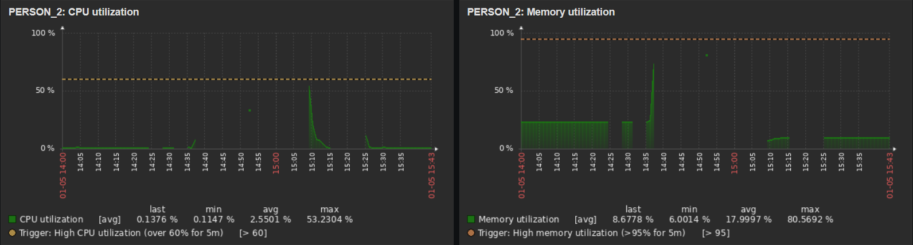
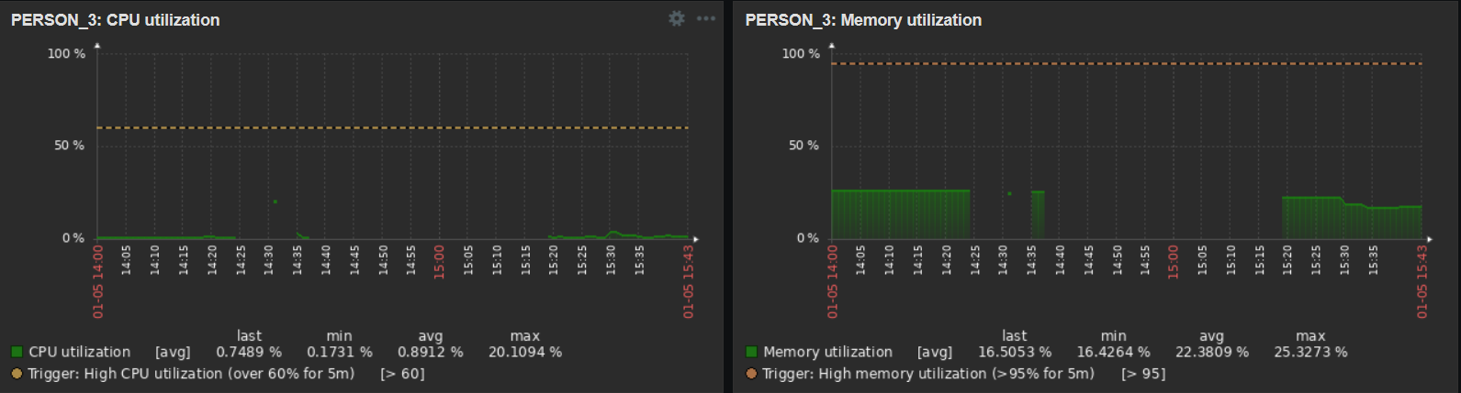
PERSON_2: CPU Utilization
PERSON_2: Memory Utilization
PERSON_3: CPU Utilization
PERSON_3: Memory Utilization

Slide 7
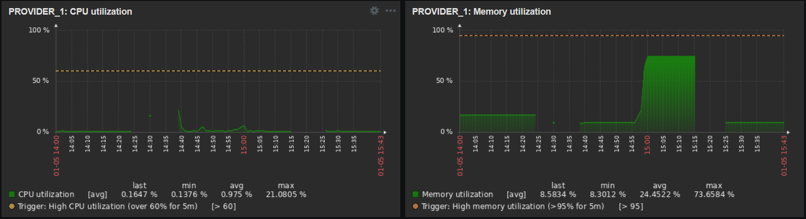
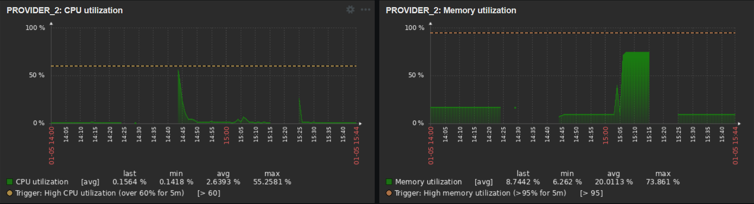
PROVIDER_1: CPU Utilization
PROVIDER_1: Memory Utilization
PROVIDER_2: CPU Utilization
PROVIDER_2: Memory Utilization

Slide 8
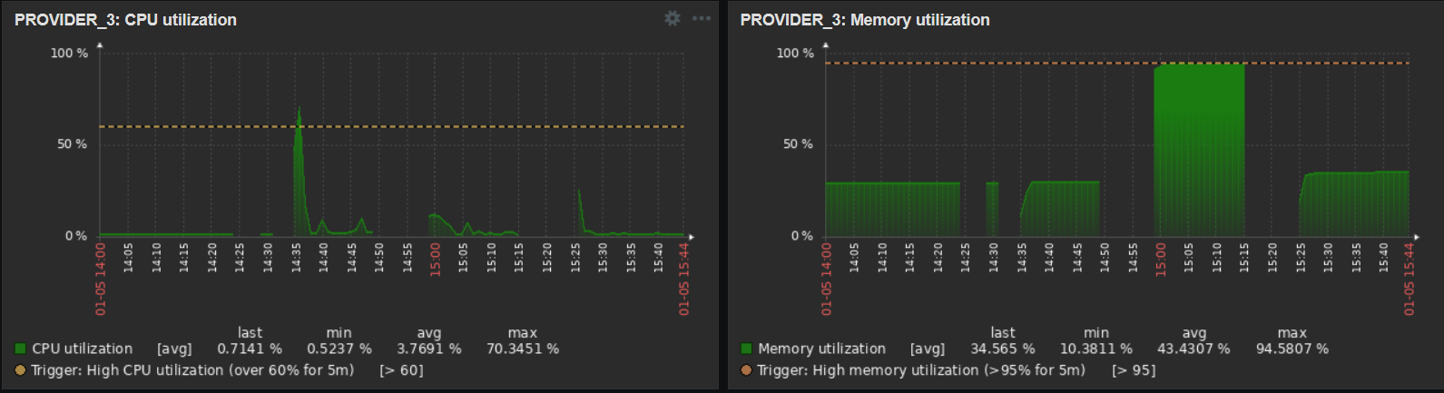
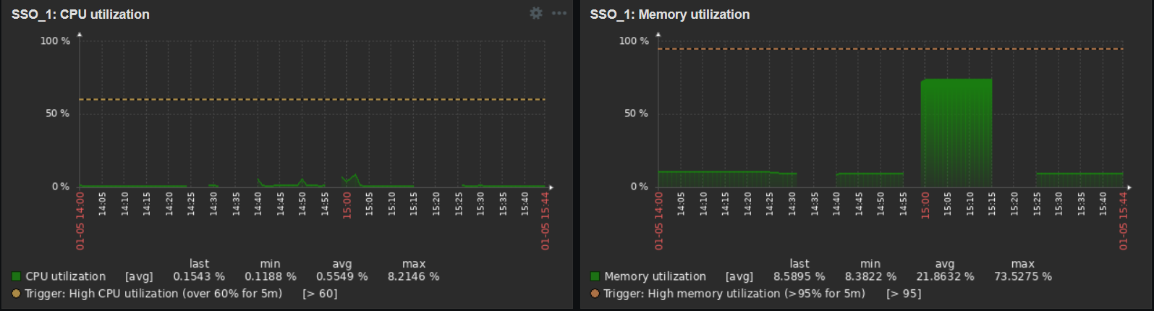
PROVIDER_3: CPU Utilization
PROVIDER_3: Memory Utilization
SSO_1: CPU Utilization
SSO_1: Memory Utilization

Slide 9
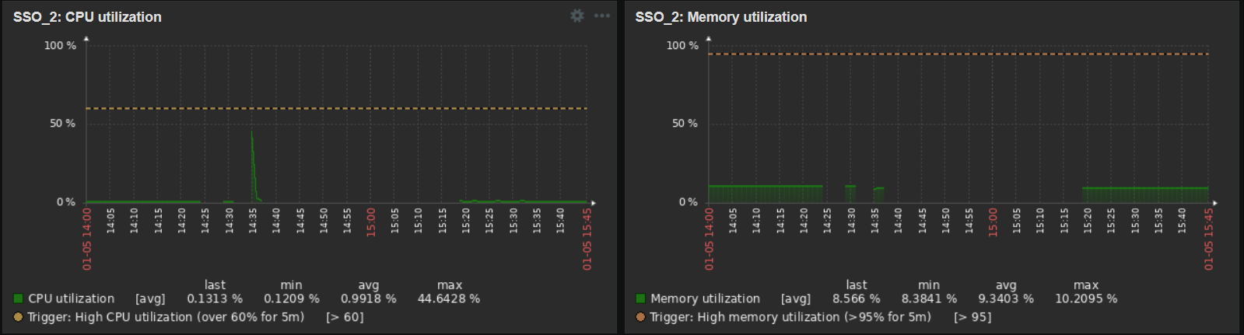
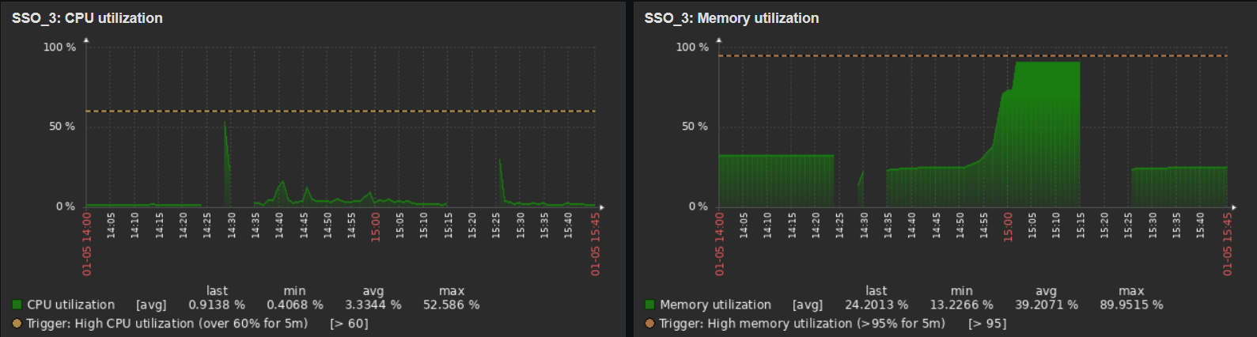
SSO_2: CPU Utilization
SSO_2: Memory Utilization
SSO_3: CPU Utilization
SSO_3: Memory Utilization

Slide 10
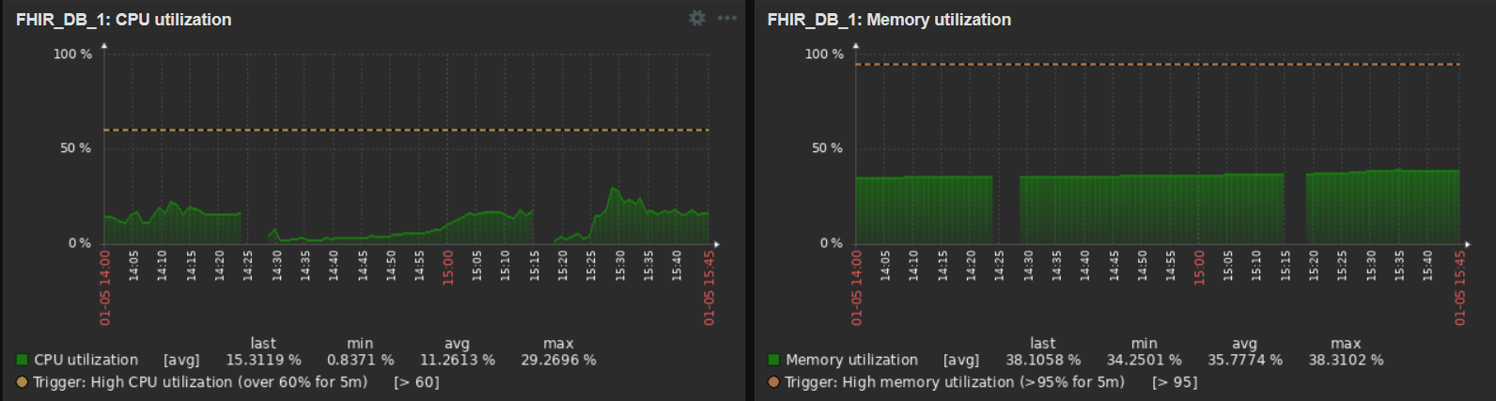
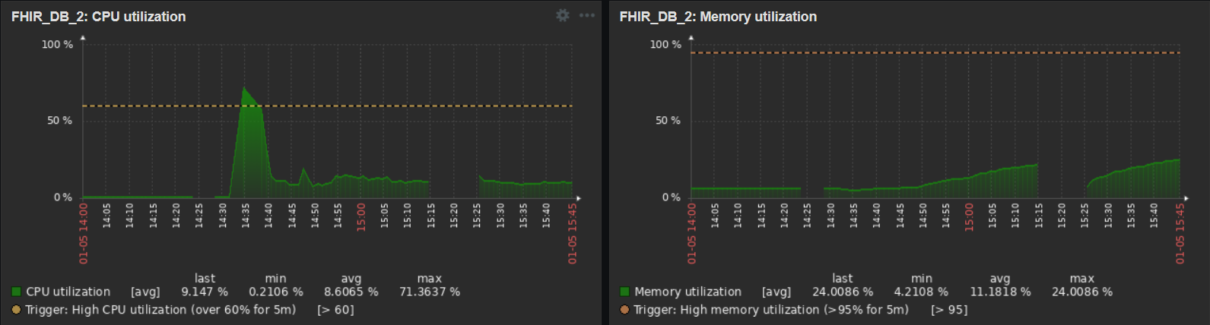
FHIR_DB_1: CPU Utilization
FHIR_DB_1: Memory Utilization
FHIR_DB_2: CPU Utilization
FHIR_DB_2: Memory Utilization

Slide 11
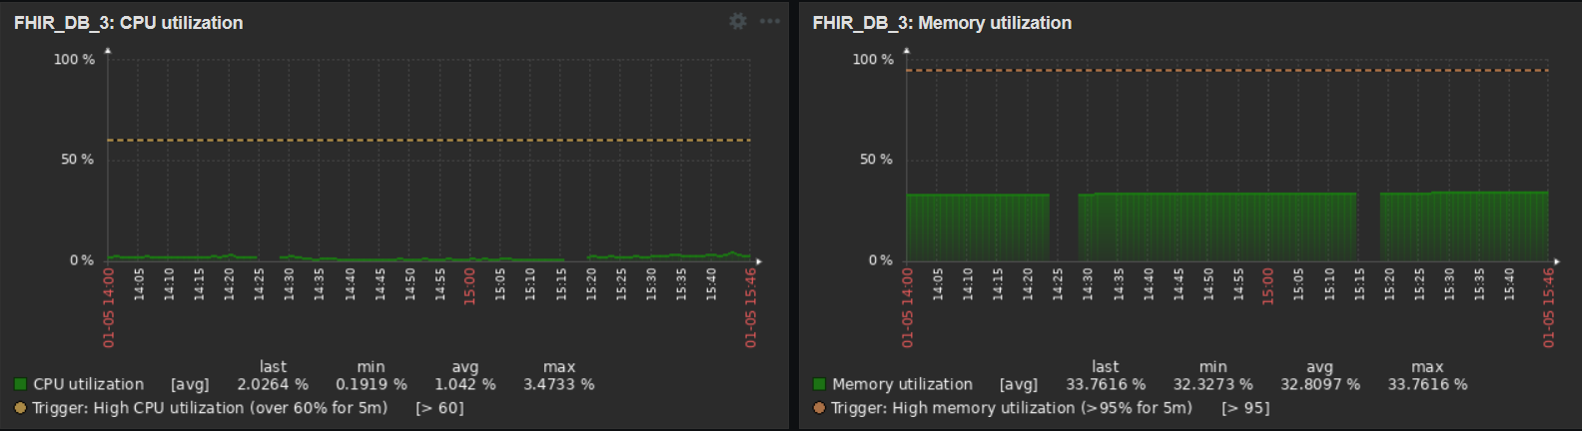
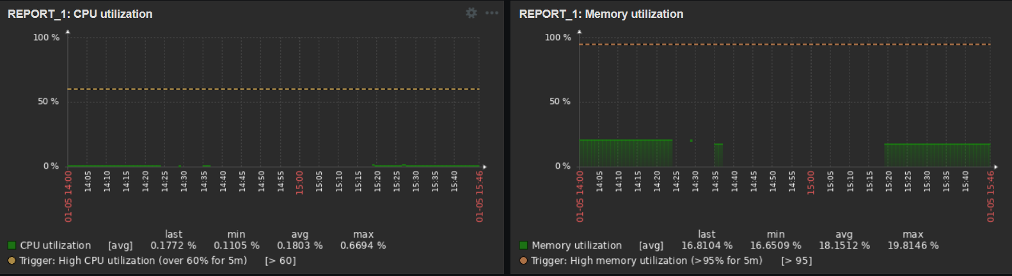
FHIR_DB_3: CPU Utilization
FHIR_DB_3: Memory Utilization
REPORT_1: CPU Utilization
REPORT_1: Memory Utilization

Slide 12
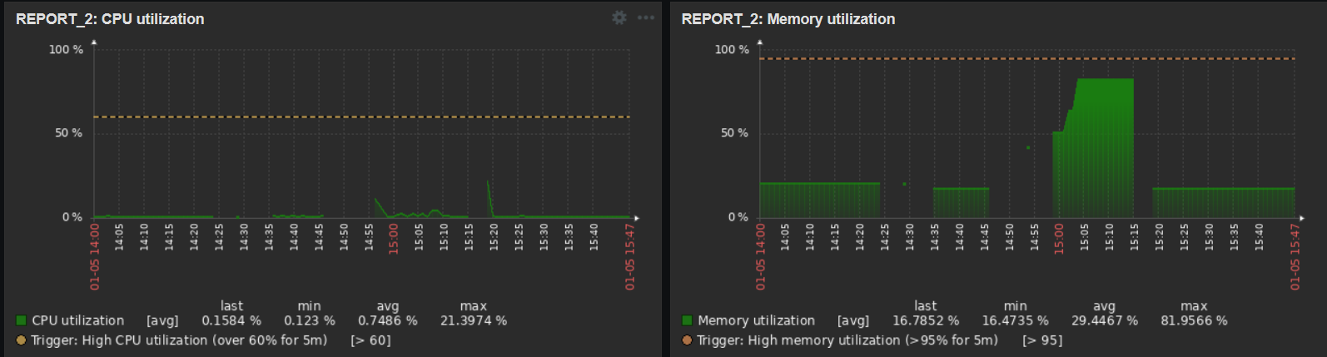
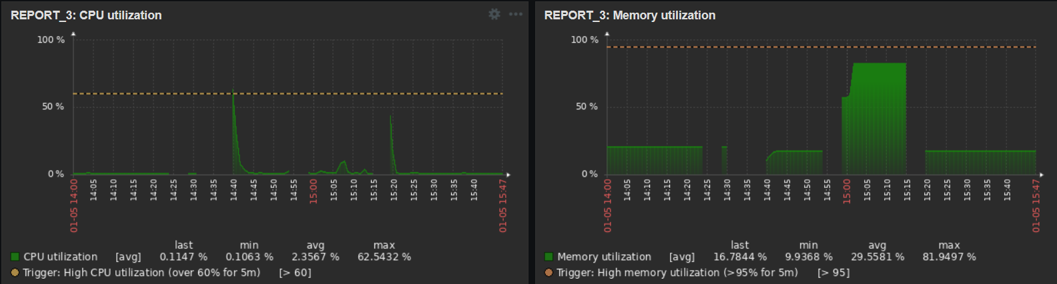
REPORT_2: CPU Utilization
REPORT_2: Memory Utilization
REPORT_3: CPU Utilization
REPORT_3: Memory Utilization

Slide 13
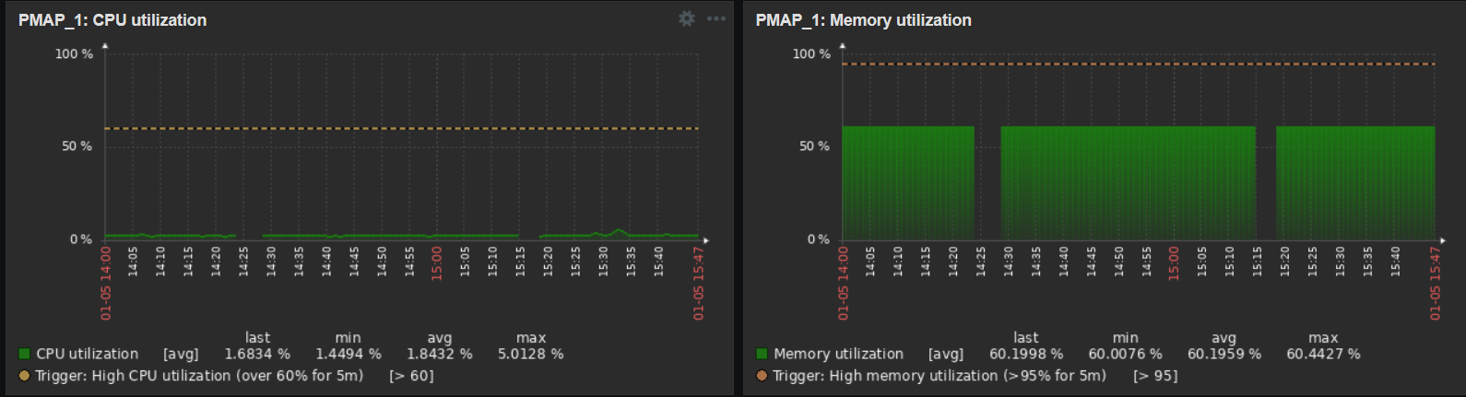
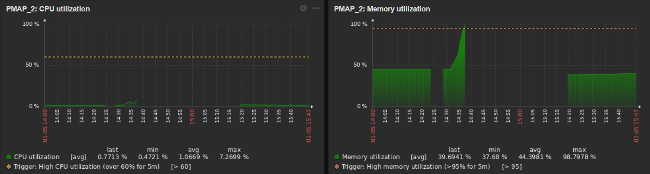
PMAP_1: CPU Utilization
PMAP_1: Memory Utilization
PMAP_2: CPU Utilization
PMAP_2: Memory Utilization

Slide 14
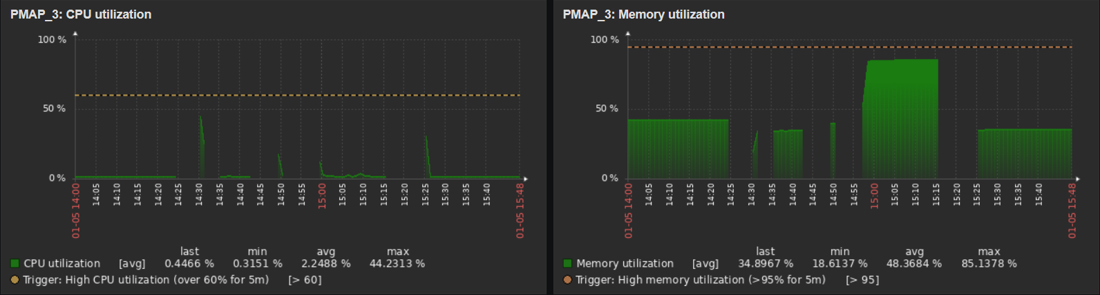
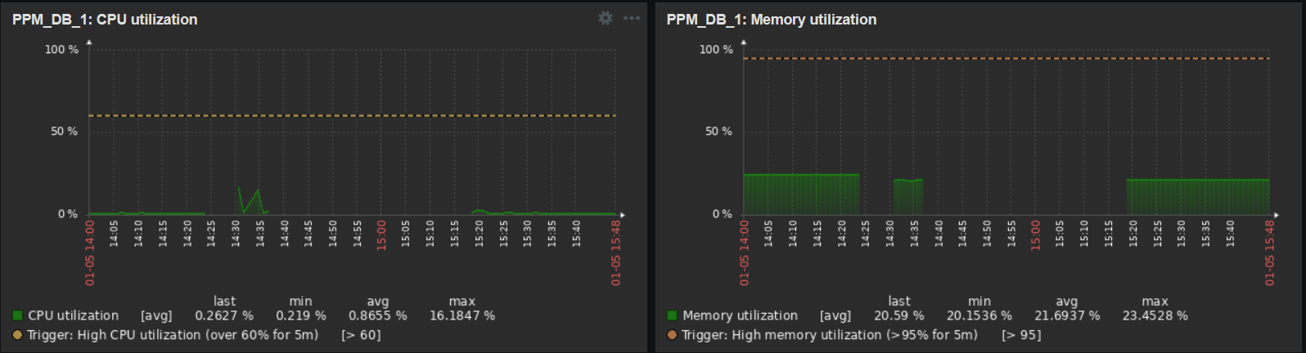
PMAP_3: CPU Utilization
PMAP_3: Memory Utilization
PPM_DB_1: CPU Utilization
PPM_DB_1: Memory Utilization

Slide 15
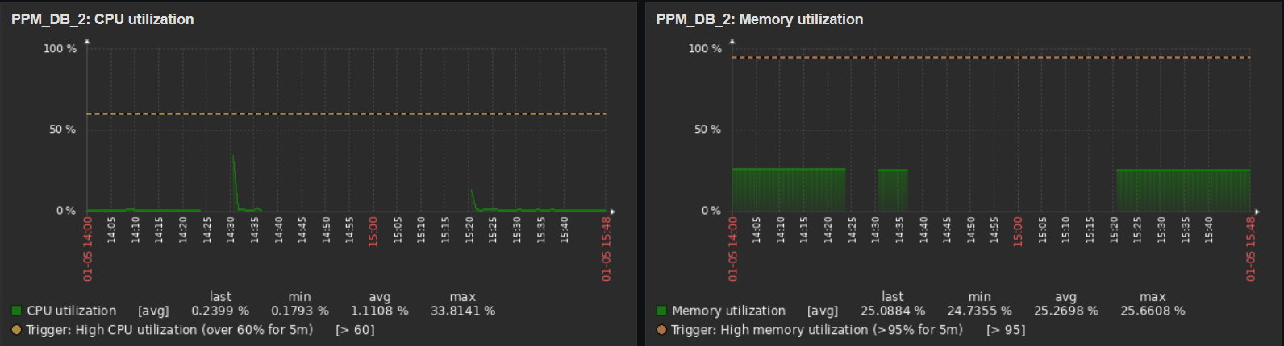
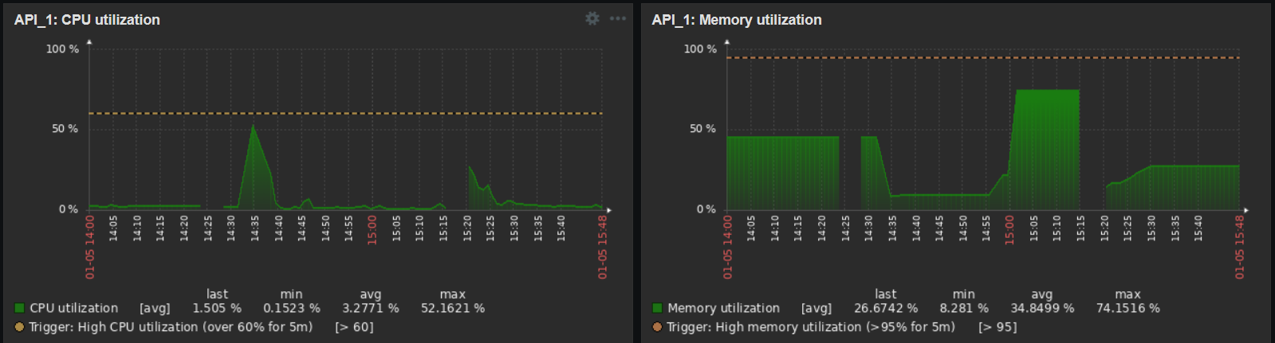
PPM_DB_2: CPU Utilization
PPM_DB_2: Memory Utilization
API_1: CPU Utilization
API_1: Memory Utilization

Slide 16
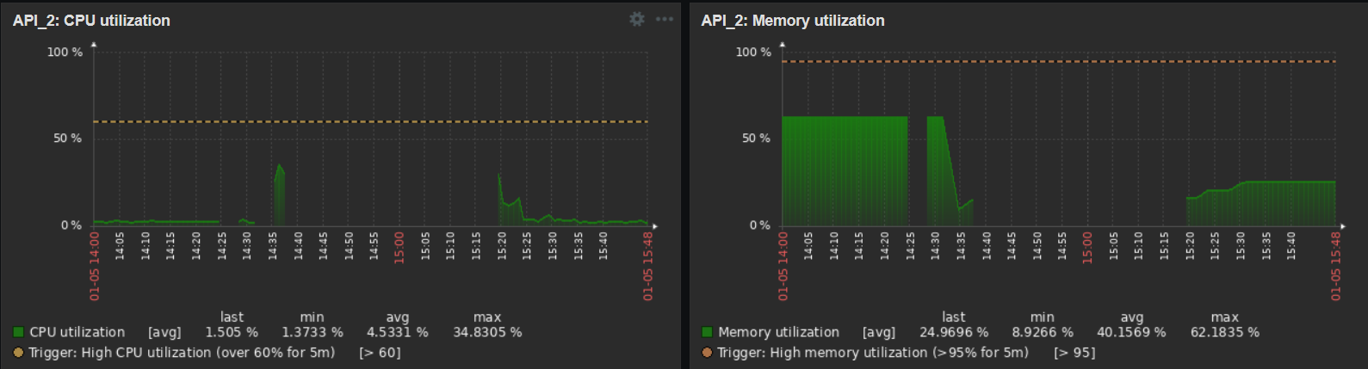
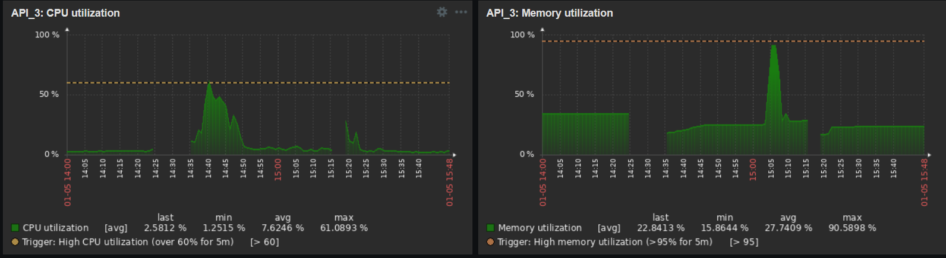
API_2: CPU Utilization
API_2: Memory Utilization
API_3: CPU Utilization
API_3: Memory Utilization

Slide 17
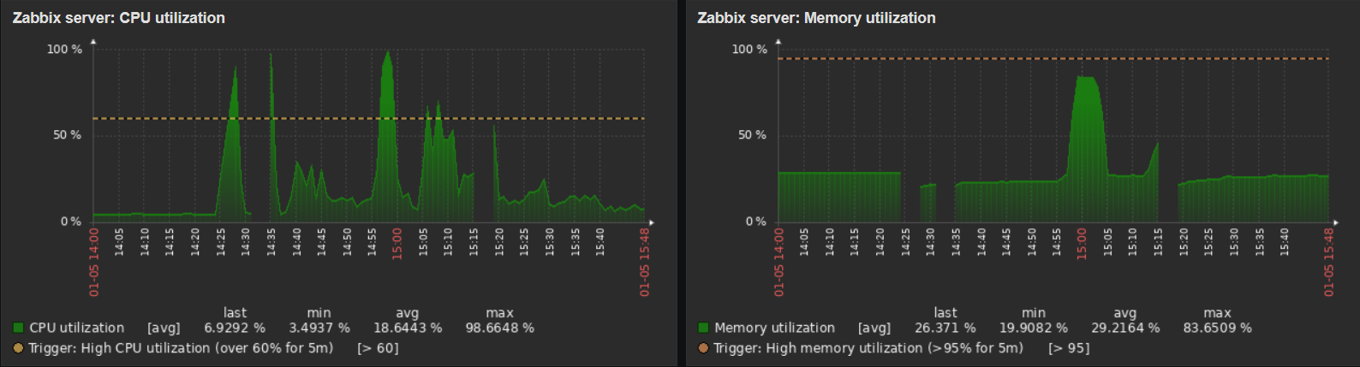
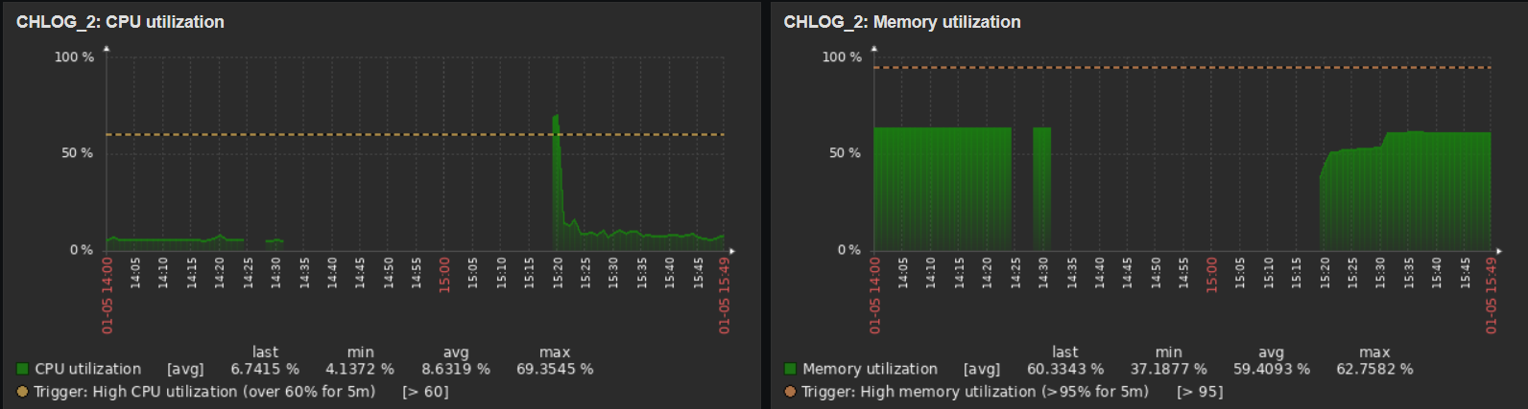
CHLOG_1 : CPU Utilization
CHLOG_1 : Memory Utilization
CHLOG_2: CPU Utilization
CHLOG_2 : Memory Utilization

Slide 18
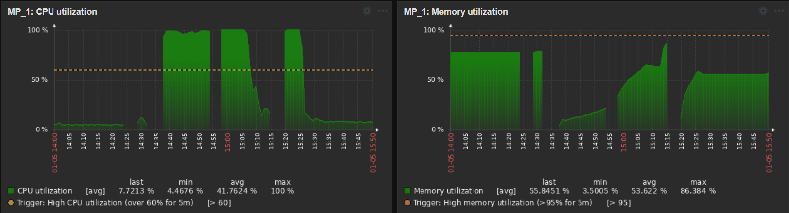
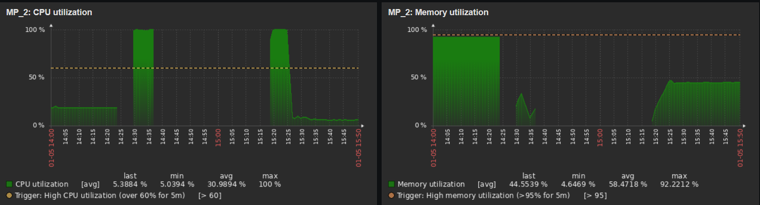
MP_1: CPU Utilization
MP_1: Memory Utilization
MP_2: CPU Utilization
MP_2: Memory Utilization

Slide 19
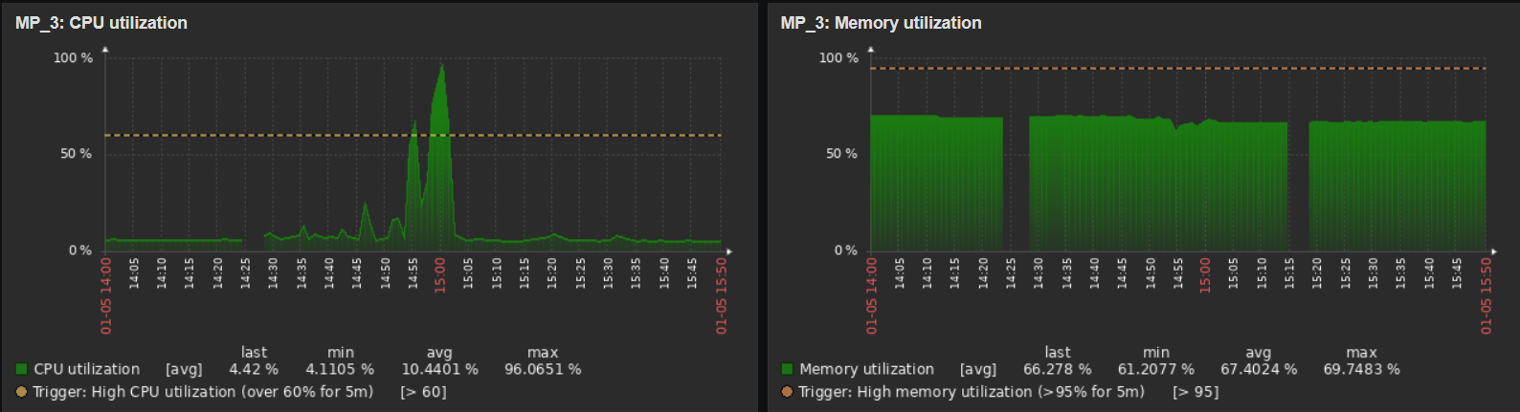
MP_3: CPU Utilization
MP_3: Memory Utilization
Notes:
Update: 5 January 2024

Slide 20
Network Disconnect on 23/1/2024
0950 HRS – 1000 HRS

Slide 21
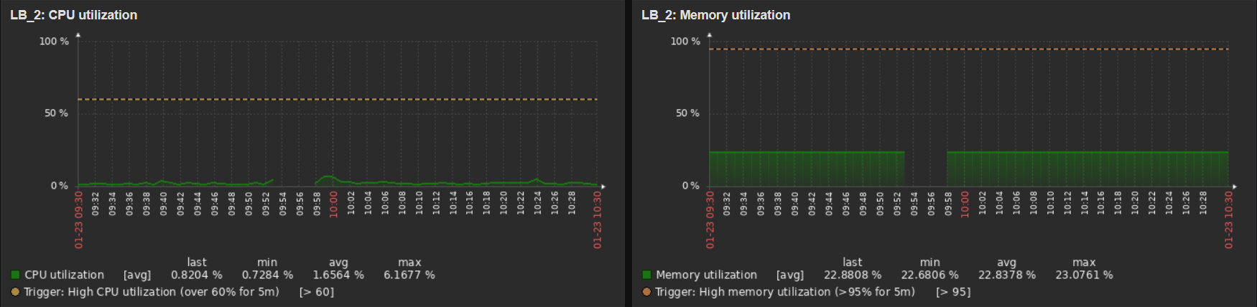
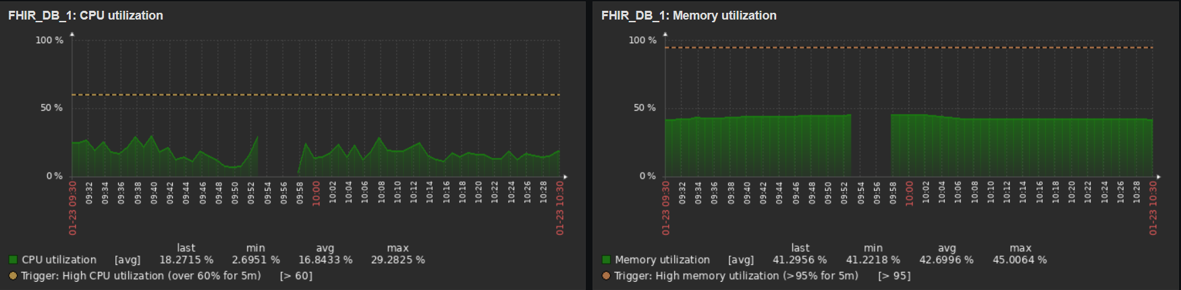
LB_2: CPU Utilization
LB_2: Memory Utilization
FHIR_DB_1: CPU Utilization
FHIR_DB_1: Memory Utilization

Slide 22
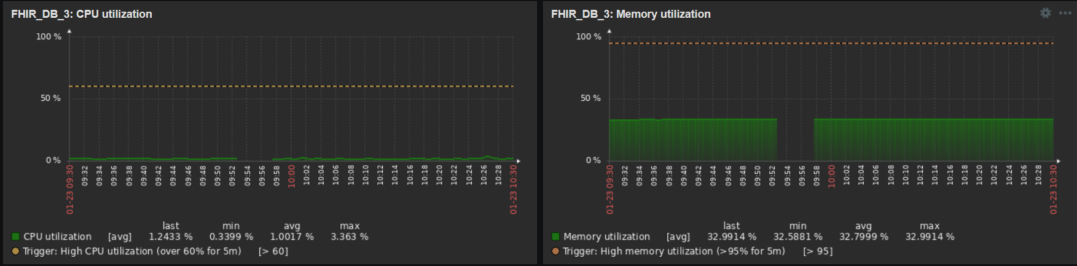
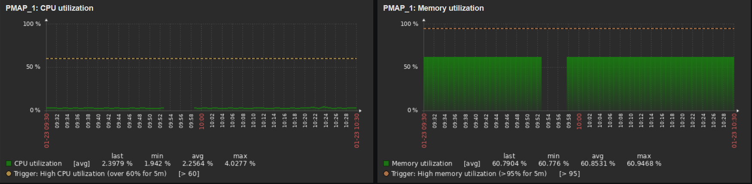
FHIR_DB_3: CPU Utilization
FHIR_DB_3: Memory Utilization
PMAP_1: CPU Utilization
PMAP_1: Memory Utilization

Slide 23
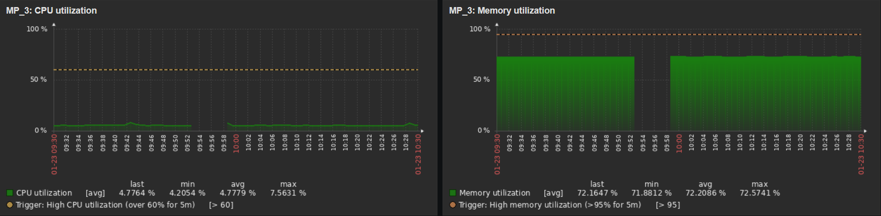
MP_3: CPU Utilization
MP_3: Memory Utilization
Notes:
Update: 23 January 2024

Slide 24
FEBRUARY
Downtime:
5/2/2024
11/2/2024
12/2/2024
13/2/2024
14/2/2024
19/2/2024
21/2/2024

Slide 25
Network Disconnect on 5/2/2024
1630 HRS – 1645 HRS

Slide 26
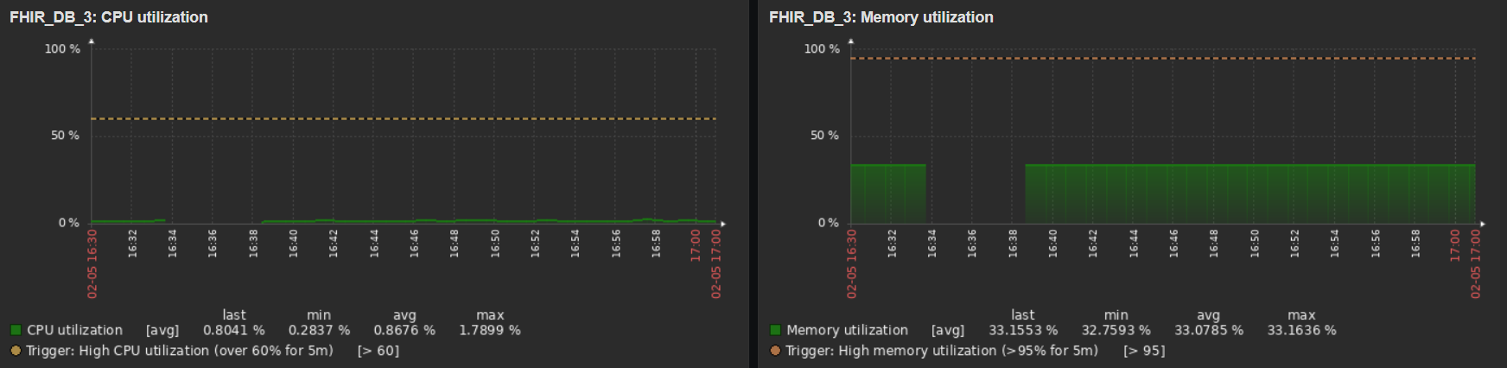
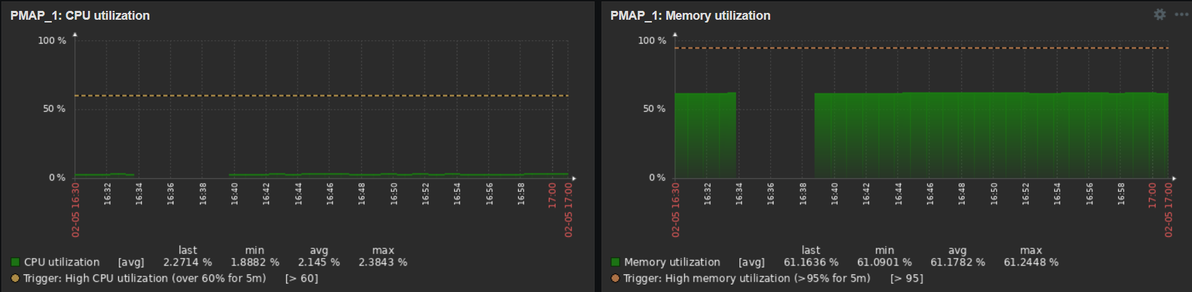
FHIR_DB_3: CPU Utilization
FHIR_DB_3: Memory Utilization
PMAP_1: CPU Utilization
PMAP_1: Memory Utilization

Slide 27
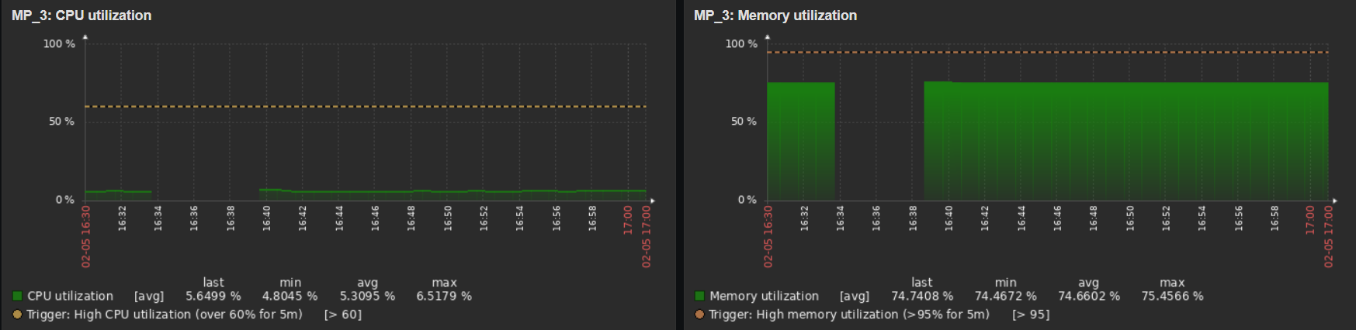
MP_3: CPU Utilization
MP_3: Memory Utilization

Slide 28
Network Disconnect on 11/2/2024
1430 HRS – 1900 HRS
2230 HRS – 2330 HRS

Slide 29
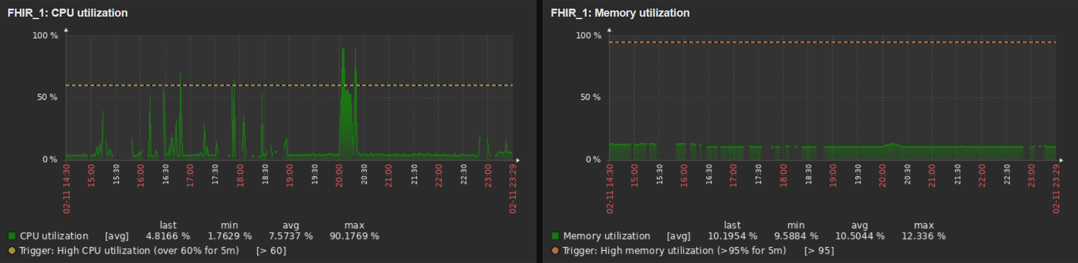
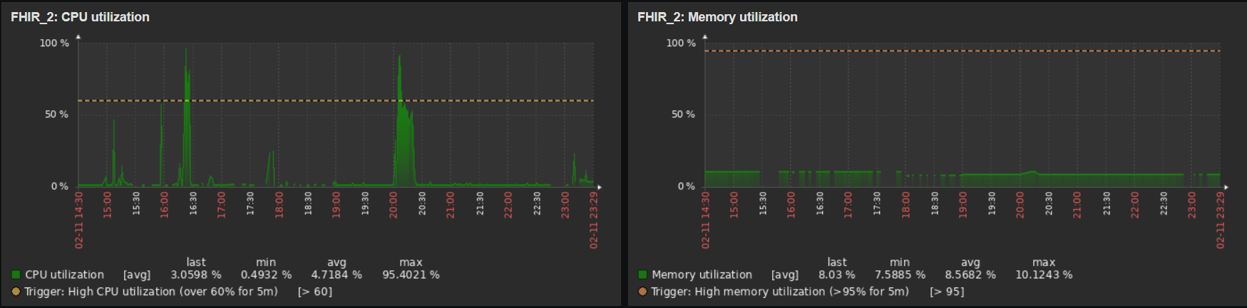
FHIR_1: CPU Utilization
FHIR_1: Memory Utilization
FHIR_2: CPU Utilization
FHIR_2: Memory Utilization

Slide 30
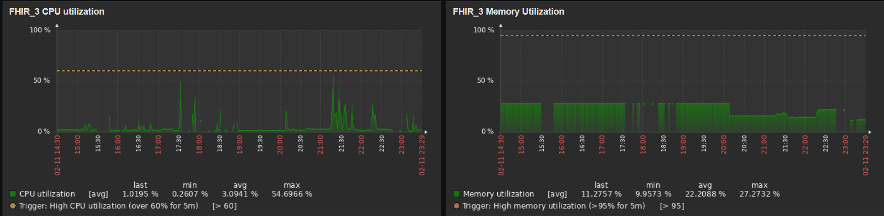
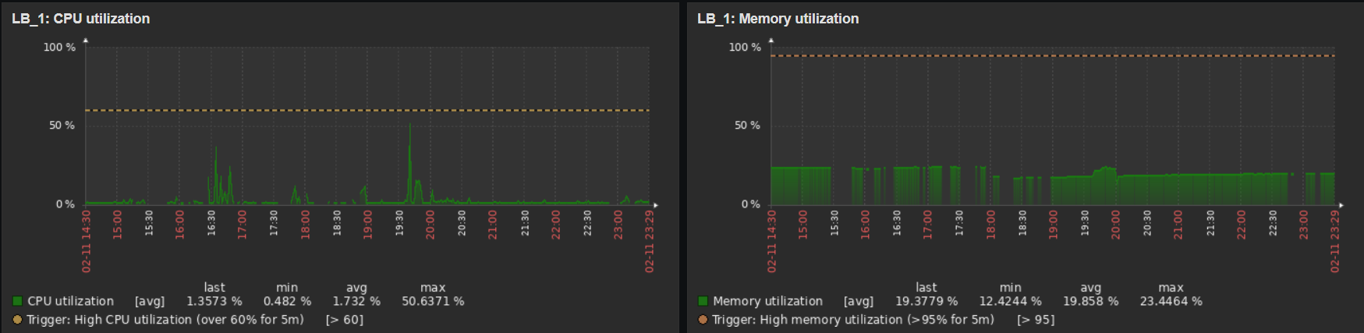
FHIR_3: CPU Utilization
FHIR_3: Memory Utilization
LB_1: CPU Utilization
LB_1: Memory Utilization

Slide 31
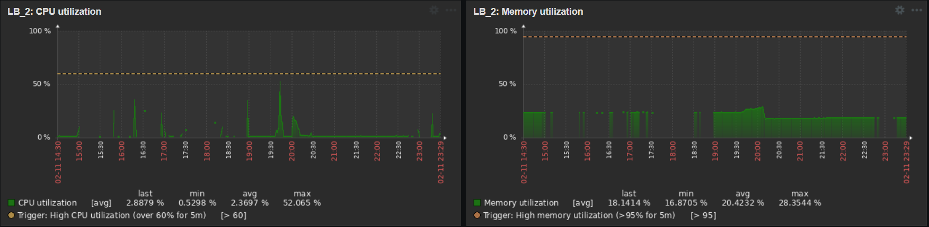
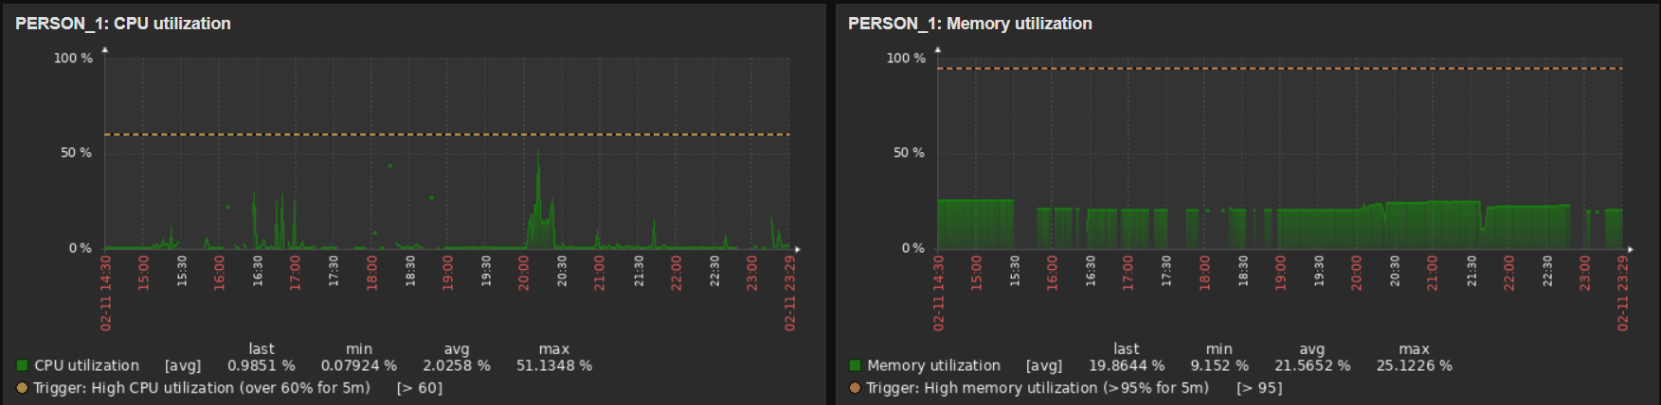
LB_2: CPU Utilization
LB_2: Memory Utilization
PERSON_1: CPU Utilization
PERSON_1: Memory Utilization

Slide 32
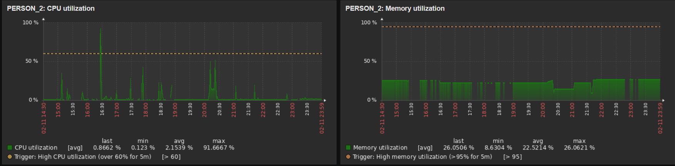
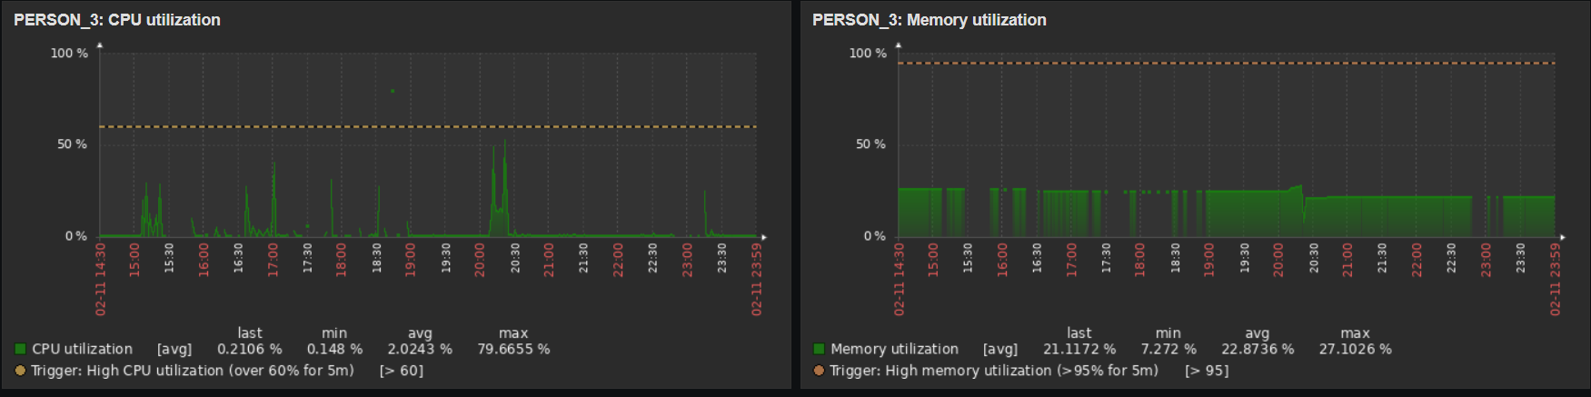
PERSON_2: CPU Utilization
PERSON_2: Memory Utilization
PERSON_3: CPU Utilization
PERSON_3: Memory Utilization

Slide 33
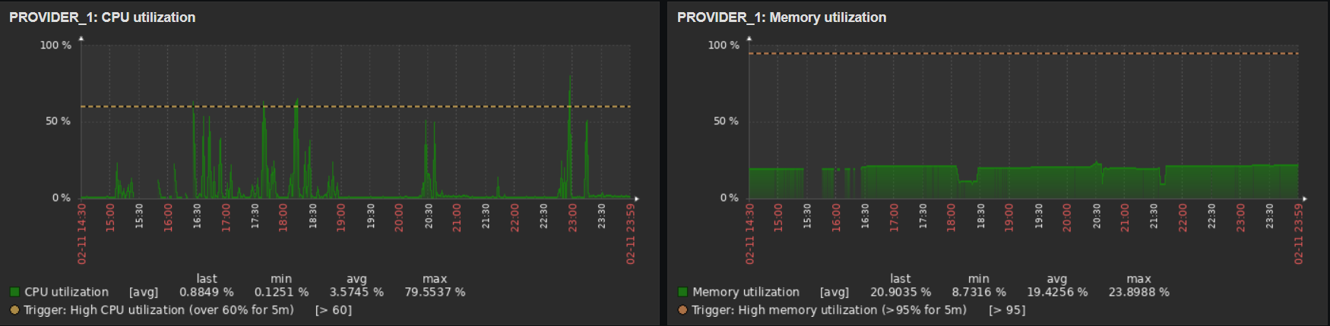

PROVIDER_1: CPU Utilization
PROVIDER_1: Memory Utilization
PROVIDER_2: CPU Utilization
PROVIDER_2: Memory Utilization

Slide 34


PROVIDER_3: CPU Utilization
PROVIDER_3: Memory Utilization
SSO_1: CPU Utilization
SSO_1: Memory Utilization

Slide 35


SSO_2: CPU Utilization
SSO_2: Memory Utilization
SSO_3: CPU Utilization
SSO_3: Memory Utilization

Slide 36


FHIR_DB_1: CPU Utilization
FHIR_DB_1: Memory Utilization
FHIR_DB_2: CPU Utilization
FHIR_DB_2: Memory Utilization

Slide 37


FHIR_DB_3: CPU Utilization
FHIR_DB_3: Memory Utilization
REPORT_1: CPU Utilization
REPORT_1: Memory Utilization

Slide 38


REPORT_2: CPU Utilization
REPORT_2: Memory Utilization
REPORT_3: CPU Utilization
REPORT_3: Memory Utilization

Slide 39


PMAP_1: CPU Utilization
PMAP_1: Memory Utilization
PMAP_2: CPU Utilization
PMAP_2: Memory Utilization

Slide 40


PMAP_3: CPU Utilization
PMAP_3: Memory Utilization
PPM_DB_1: CPU Utilization
PPM_DB_1: Memory Utilization

Slide 41


PPM_DB_2: CPU Utilization
PPM_DB_2: Memory Utilization
API_1: CPU Utilization
API_1: Memory Utilization

Slide 42


API_2: CPU Utilization
API_2: Memory Utilization
API_3: CPU Utilization
API_3: Memory Utilization

Slide 43


CHLOG_2: CPU Utilization
CHLOG_2 : Memory Utilization
MP_1: CPU Utilization
MP_1: Memory Utilization

Slide 44


MP_2: CPU Utilization
MP_2: Memory Utilization
MP_3: CPU Utilization
MP_3: Memory Utilization

Slide 45
Network Disconnect on 12/2/2024
1630 HRS – 1730 HRS
2100 HRS – 2200 HRS

Slide 46


FHIR_1: CPU Utilization
FHIR_1: Memory Utilization
FHIR_2: CPU Utilization
FHIR_2: Memory Utilization

Slide 47


FHIR_3: CPU Utilization
FHIR_3: Memory Utilization
LB_1: CPU Utilization
LB_1: Memory Utilization

Slide 48


LB_2: CPU Utilization
LB_2: Memory Utilization
PERSON_1: CPU Utilization
PERSON_1: Memory Utilization

Slide 49


PERSON_2: CPU Utilization
PERSON_2: Memory Utilization
PERSON_3: CPU Utilization
PERSON_3: Memory Utilization

Slide 50


PROVIDER_1: CPU Utilization
PROVIDER_1: Memory Utilization
PROVIDER_2: CPU Utilization
PROVIDER_2: Memory Utilization

Slide 51


PROVIDER_3: CPU Utilization
PROVIDER_3: Memory Utilization
SSO_1: CPU Utilization
SSO_1: Memory Utilization

Slide 52


SSO_3: CPU Utilization
SSO_3: Memory Utilization
FHIR_DB_1: CPU Utilization
FHIR_DB_1: Memory Utilization

Slide 53


FHIR_DB_2: CPU Utilization
FHIR_DB_2: Memory Utilization
FHIR_DB_3: CPU Utilization
FHIR_DB_3: Memory Utilization

Slide 54


REPORT_1: CPU Utilization
REPORT_1: Memory Utilization
REPORT_2: CPU Utilization
REPORT_2: Memory Utilization

Slide 55


REPORT_3: CPU Utilization
REPORT_3: Memory Utilization
PMAP_1: CPU Utilization
PMAP_1: Memory Utilization

Slide 56


PMAP_3: CPU Utilization
PMAP_3: Memory Utilization
PPM_DB_1: CPU Utilization
PPM_DB_1: Memory Utilization

Slide 57


API_1: CPU Utilization
API_1: Memory Utilization
API_2: CPU Utilization
API_2: Memory Utilization

Slide 58


API_3: CPU Utilization
API_3: Memory Utilization
CHLOG_2: CPU Utilization
CHLOG_2 : Memory Utilization

Slide 59


MP_1: CPU Utilization
MP_1: Memory Utilization
MP_2: CPU Utilization
MP_2: Memory Utilization

Slide 60

MP_3: CPU Utilization
MP_3: Memory Utilization

Slide 61
Network Disconnect on 13/2/2024
0700 HRS – 0800 HRS
0915 HRS – 1000 HRS
1700 HRS – 2359 HRS

Slide 62


FHIR_1: CPU Utilization
FHIR_1: Memory Utilization
FHIR_2: CPU Utilization
FHIR_2: Memory Utilization

Slide 63


FHIR_3: CPU Utilization
FHIR_3: Memory Utilization
LB_1: CPU Utilization
LB_1: Memory Utilization

Slide 64


LB_2: CPU Utilization
LB_2: Memory Utilization
PERSON_1: CPU Utilization
PERSON_1: Memory Utilization

Slide 65


PERSON_2: CPU Utilization
PERSON_2: Memory Utilization
PERSON_3: CPU Utilization
PERSON_3: Memory Utilization

Slide 66


PROVIDER_1: CPU Utilization
PROVIDER_1: Memory Utilization
PROVIDER_2: CPU Utilization
PROVIDER_2: Memory Utilization

Slide 67


PROVIDER_3: CPU Utilization
PROVIDER_3: Memory Utilization
SSO_1: CPU Utilization
SSO_1: Memory Utilization

Slide 68


SSO_2: CPU Utilization
SSO_2: Memory Utilization
SSO_3: CPU Utilization
SSO_3: Memory Utilization

Slide 69


FHIR_DB_1: CPU Utilization
FHIR_DB_1: Memory Utilization
FHIR_DB_2: CPU Utilization
FHIR_DB_2: Memory Utilization

Slide 70


FHIR_DB_3: CPU Utilization
FHIR_DB_3: Memory Utilization
REPORT_1: CPU Utilization
REPORT_1: Memory Utilization

Slide 71


REPORT_2: CPU Utilization
REPORT_2: Memory Utilization
REPORT_3: CPU Utilization
REPORT_3: Memory Utilization

Slide 72


PMAP_1: CPU Utilization
PMAP_1: Memory Utilization
PMAP_2: CPU Utilization
PMAP_2: Memory Utilization

Slide 73


PMAP_3: CPU Utilization
PMAP_3: Memory Utilization
PPM_DB_1: CPU Utilization
PPM_DB_1: Memory Utilization

Slide 74


PPM_DB_2: CPU Utilization
PPM_DB_2: Memory Utilization
API_1: CPU Utilization
API_1: Memory Utilization

Slide 75


API_2: CPU Utilization
API_2: Memory Utilization
API_3: CPU Utilization
API_3: Memory Utilization

Slide 76


CHLOG_1: CPU Utilization
CHLOG_1: Memory Utilization
CHLOG_2: CPU Utilization
CHLOG_2: Memory Utilization

Slide 77


MP_1: CPU Utilization
MP_1: Memory Utilization
MP_2: CPU Utilization
MP_2: Memory Utilization

Slide 78

MP_3: CPU Utilization
MP_3: Memory Utilization

Slide 79
Network Disconnect on 14/2/2024
0000 HRS – 1130 HRS

Slide 80


FHIR_1: CPU Utilization
FHIR_1: Memory Utilization
FHIR_2: CPU Utilization
FHIR_2: Memory Utilization

Slide 81


FHIR_3: CPU Utilization
FHIR_3: Memory Utilization
LB_1: CPU Utilization
LB_1: Memory Utilization

Slide 82


LB_2: CPU Utilization
LB_2: Memory Utilization
PERSON_1: CPU Utilization
PERSON_1: Memory Utilization

Slide 83


PERSON_2: CPU Utilization
PERSON_2: Memory Utilization
PERSON_3: CPU Utilization
PERSON_3: Memory Utilization

Slide 84


PROVIDER_1: CPU Utilization
PROVIDER_1: Memory Utilization
PROVIDER_2: CPU Utilization
PROVIDER_2: Memory Utilization

Slide 85


PROVIDER_3: CPU Utilization
PROVIDER_3: Memory Utilization
SSO_1: CPU Utilization
SSO_1: Memory Utilization

Slide 86


SSO_2: CPU Utilization
SSO_2: Memory Utilization
SSO_3: CPU Utilization
SSO_3: Memory Utilization

Slide 87


FHIR_DB_1: CPU Utilization
FHIR_DB_1: Memory Utilization
FHIR_DB_2: CPU Utilization
FHIR_DB_2: Memory Utilization

Slide 88


FHIR_DB_3: CPU Utilization
FHIR_DB_3: Memory Utilization
REPORT_1: CPU Utilization
REPORT_1: Memory Utilization

Slide 89


REPORT_2: CPU Utilization
REPORT_2: Memory Utilization
REPORT_3: CPU Utilization
REPORT_3: Memory Utilization

Slide 90


PMAP_1: CPU Utilization
PMAP_1: Memory Utilization
PMAP_2: CPU Utilization
PMAP_2: Memory Utilization

Slide 91


PMAP_3: CPU Utilization
PMAP_3: Memory Utilization
PPM_DB_1: CPU Utilization
PPM_DB_1: Memory Utilization

Slide 92


PPM_DB_2: CPU Utilization
PPM_DB_2: Memory Utilization
API_1: CPU Utilization
API_1: Memory Utilization

Slide 93


API_2: CPU Utilization
API_2: Memory Utilization
API_3: CPU Utilization
API_3: Memory Utilization

Slide 94


CHLOG_1: CPU Utilization
CHLOG_1: Memory Utilization
CHLOG_2: CPU Utilization
CHLOG_2: Memory Utilization

Slide 95


MP_1: CPU Utilization
MP_1: Memory Utilization
MP_2: CPU Utilization
MP_2: Memory Utilization

Slide 96


MP_3: CPU Utilization
MP_3: Memory Utilization

Slide 97
Network Disconnect on 19/2/2024
1500 HRS – 1520 HRS

Slide 98

LB_2: CPU Utilization
LB_2: Memory Utilization
FHIR_DB_1: CPU Utilization
FHIR_DB_1: Memory Utilization

Slide 99


FHIR_DB_3: CPU Utilization
FHIR_DB_3: Memory Utilization
PMAP_1: CPU Utilization
PMAP_1: Memory Utilization

Slide 100

MP_3: CPU Utilization
MP_3: Memory Utilization

Slide 101
Network Disconnect on 21/2/2024
1130 HRS – 1200 HRS

Slide 102


FHIR_DB_3: CPU Utilization
FHIR_DB_3: Memory Utilization
PMAP_1: CPU Utilization
PMAP_1: Memory Utilization

Slide 103

MP_3: CPU Utilization
MP_3: Memory Utilization

Slide 104
MARCH
Downtime:
14/3/2024

Slide 105
Network Disconnect on 14/3/2024
1000HRS –1030HRS

Slide 106


LB_1: CPU Utilization
LB_1: Memory Utilization
LB_2: CPU Utilization
LB_2: Memory Utilization

